Slide 1
Quantum Computing Architectures (EE274) Lecture 23
Hiu-Yung Wong
apr. 22, 2025
hiuyung.wong@sjsu.edu, Office: ENG363
http://www.sjsu.edu/people/hiuyung.wong/index.html

Slide 2
Outline
1-qubit gate and 2-qubit gate
Microwave components

Slide 3
Announcement
Project Part 2 posted

Slide 4
Copper Pair Box
Chapter 17 of “Quantum Computing Architecture and Hardware for Engineers: Step by Step”

Slide 5
DiVincenzo's criteria for QC
5 Necessary Criteria for quantum computing:
A scalable physical system with well characterized qubit (system needs to remain in the subspace of 2 level)
The ability to initialize the state of the qubits to a simple fiducial state (initialization time is important)
Long relevant decoherence times (much longer than gate time)
A "universal" set of quantum gates
A qubit-specific measurement capability (Some algorithms only works without measuring all qubits at the same time e.g. teleportation)

Slide 6
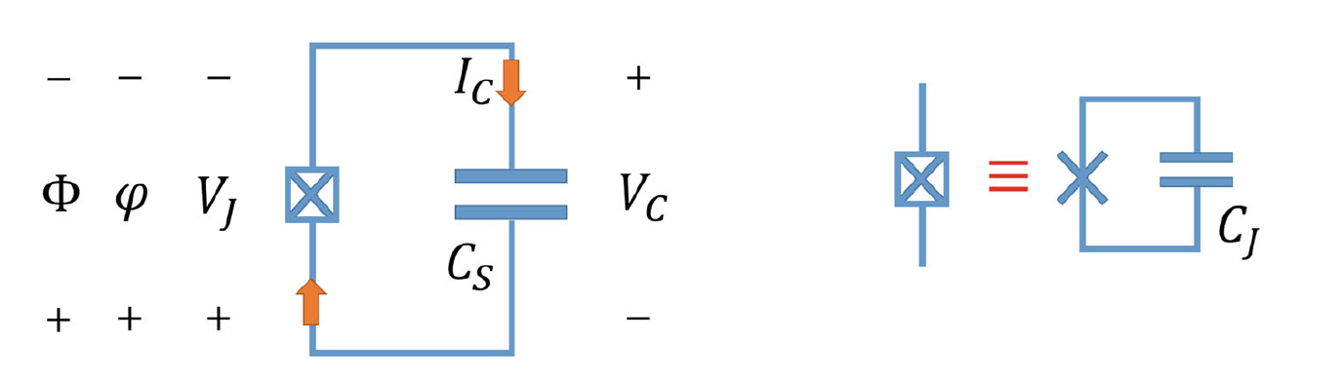
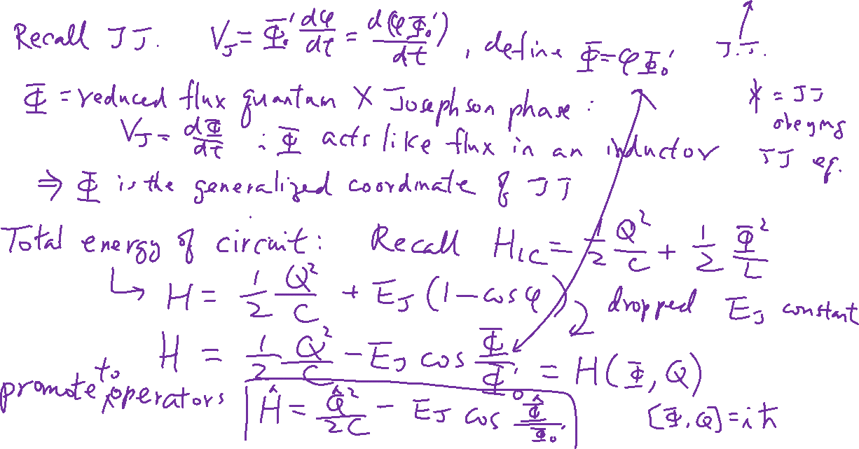
Isolated Cooper Pair Box

Slide 7
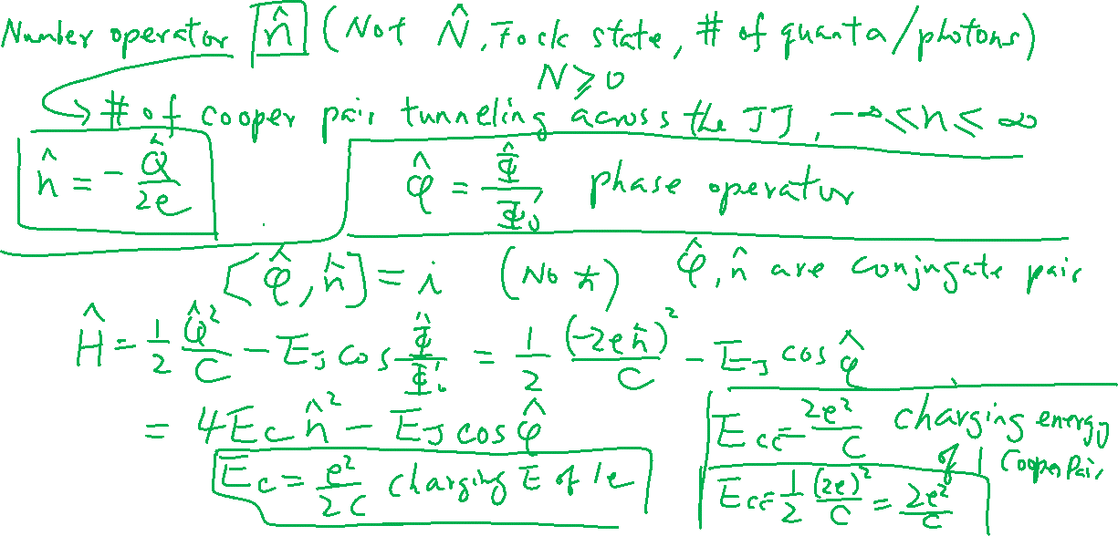
Number and Phase Operator

Slide 8
Number and Phase Operator

Slide 9
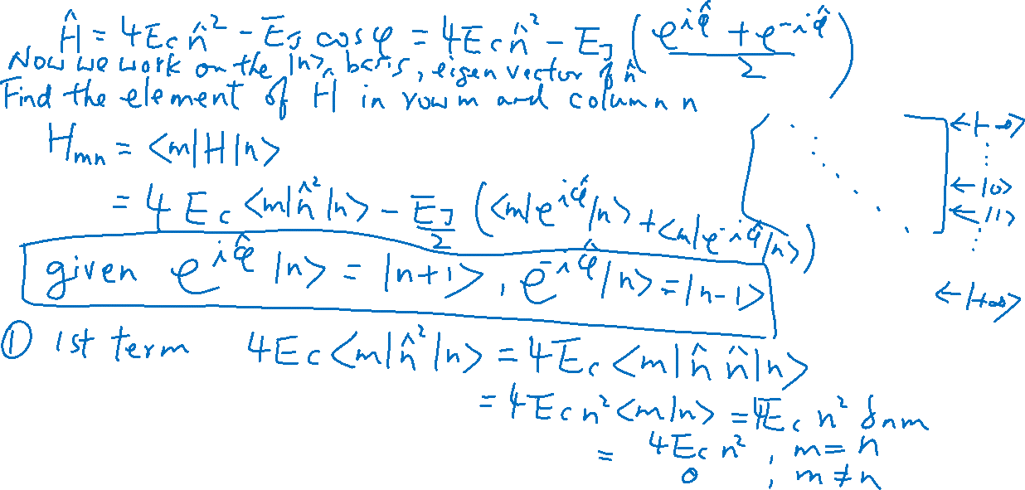
Hamiltonian in Number and Phase Operator

Slide 10
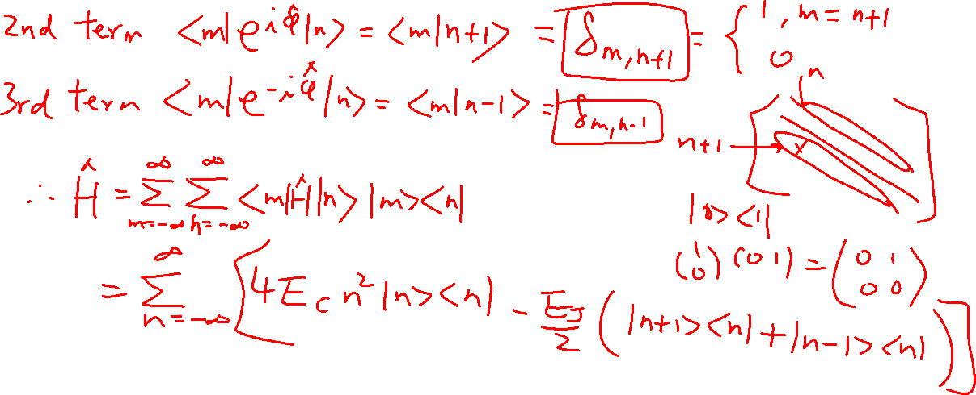
Hamiltonian in Number and Phase Operator

Slide 11
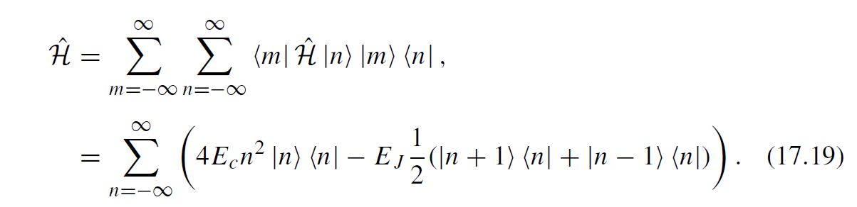
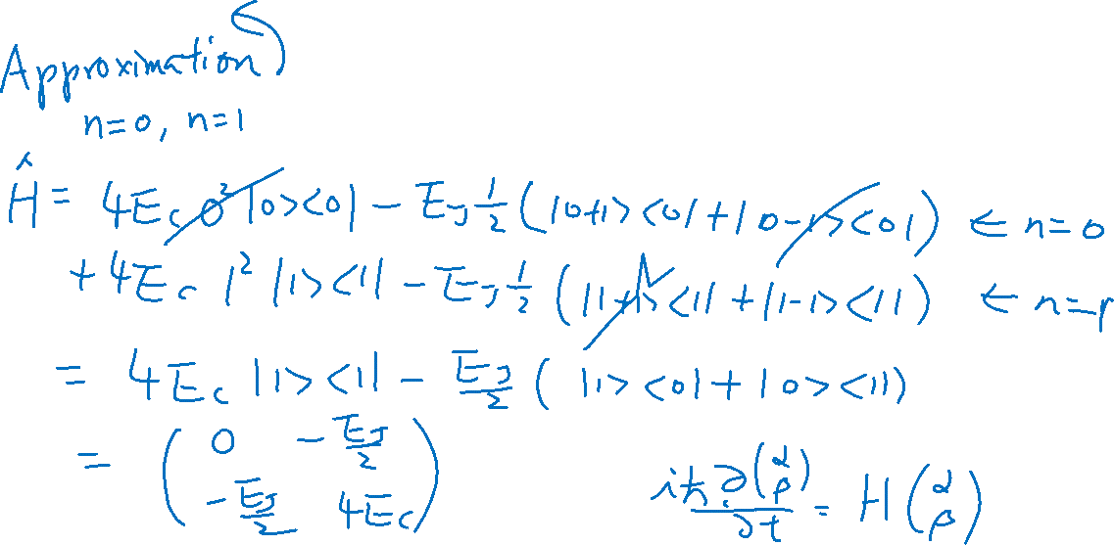
Hamiltonian in Number and Phase Operator – 2 Levels

Slide 12
Cooper Pair Box Coupled to a Voltage Source and Circuit Quanitzation
Chapter 17 of “Quantum Computing Architecture and Hardware for Engineers: Step by Step”

Slide 13
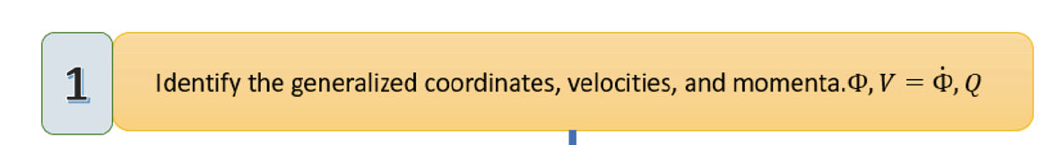
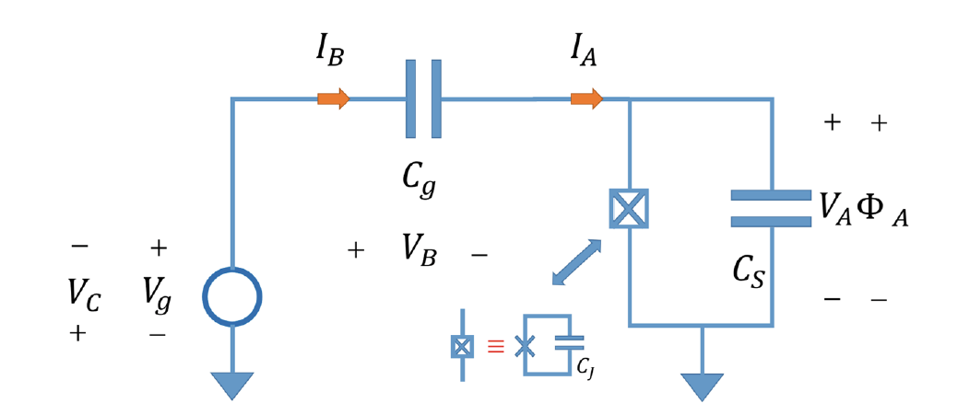
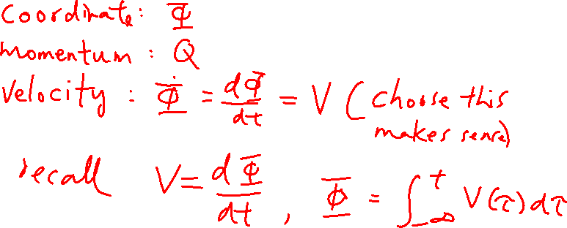
Cooper Pair Box Coupled to an Voltage Source and Quantization

Slide 14
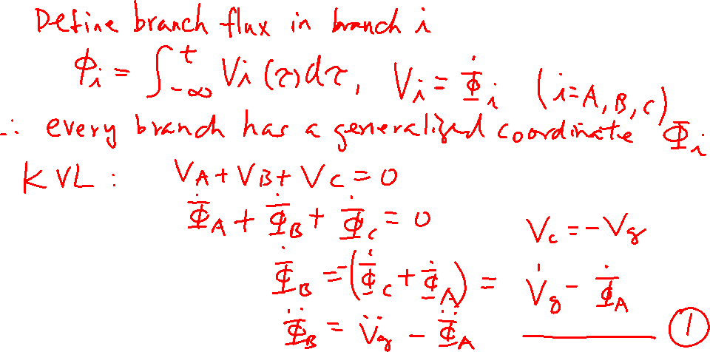
Cooper Pair Box Coupled to an Voltage Source and Quantization

